Slide 1

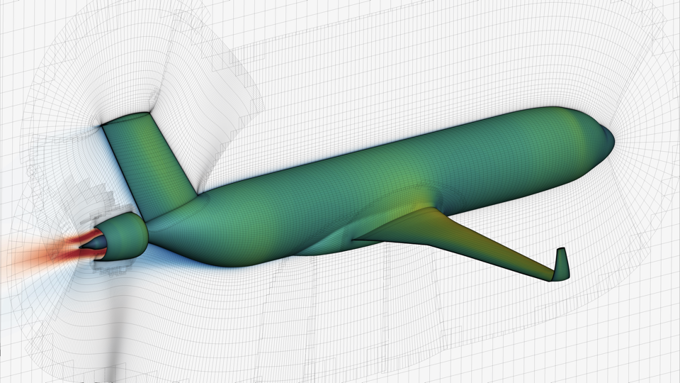
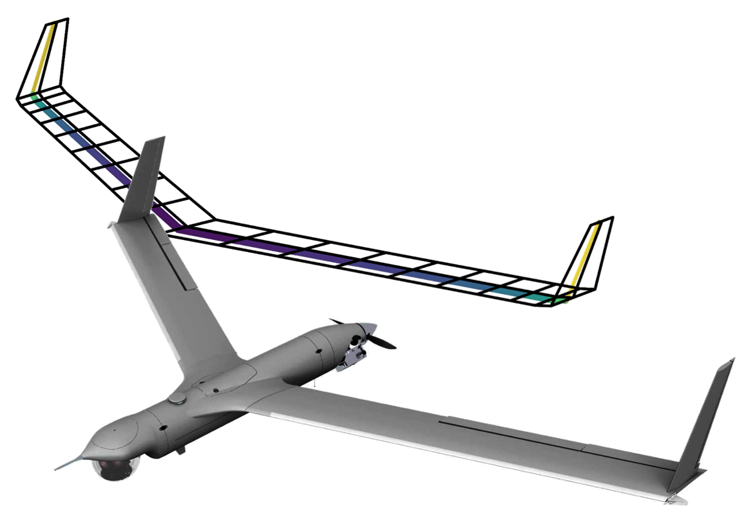
Getting derivatives in
John Jasa johnjasa@umich.edu
University of Michigan MDO Lab
Justin Gray justin.s.gray@nasa.gov
NASA Glenn Research Center

Slide 2
Acknowledgements
Ben Brelje, PhD candidate at University of Michigan MDO Lab for creating version 0 of this training
Justin Gray, Engineer and team lead of OpenMDAO at NASA Glenn for refining this workshop

Slide 3
This sessions assumes some baseline knowledge
You’ve used OpenMDAO models before
You understand when gradient-based optimization methods are advantageous
You have a working understanding of how to differentiate equations by hand

Slide 4
Download these slides and tutorial scripts from GitHub
https://github.com/openmdao/openmdao_training
Our materials for today are in the `getting_derivatives_in_openmdao` folder
This repo contains other tutorials to help you get acquainted with OpenMDAO

Slide 5
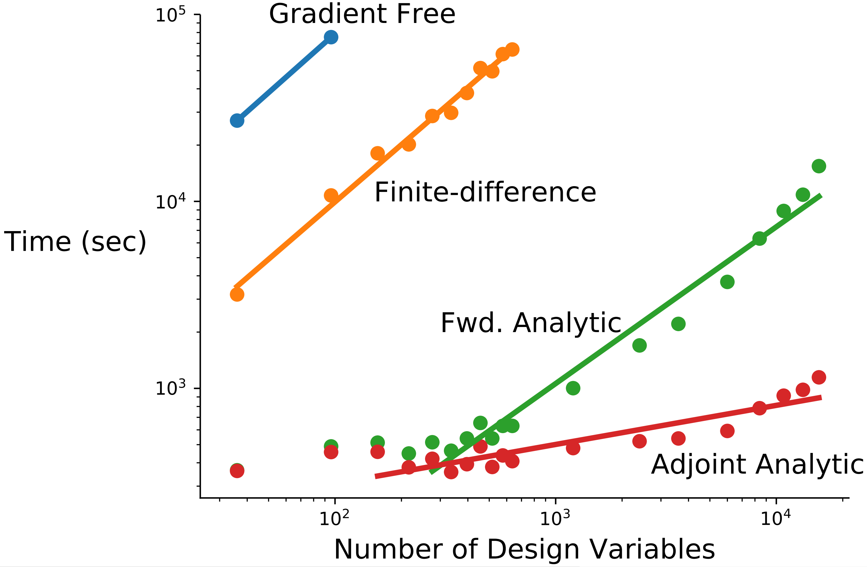
Gradient-based optimization with analytic derivatives is our only hope for large-scale problems
100x-10,000x speedup for aerodynamic shape optimization vs. gradient-free¹
At least 5x-10x speedup vs. finite-difference²
[1] Lyu et al. ICCFD8-2014-0203
[2] Gray et al. Aviation 2014-2042

Slide 6
Goals for today
Understand how to obtain partial derivatives for your components
Know the differences between explicit and implicit components and what that means for partials
Briefly learn about some advanced techniques to obtain partial derivatives

Slide 7
Brief introduction to how OpenMDAO handles derivatives
Why do we need derivatives?
How does OpenMDAO process these derivatives?
How can we efficiently obtain these derivatives?

Slide 8
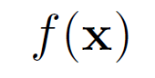
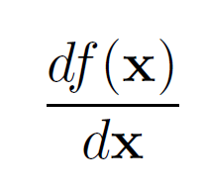
Optimization
OpenMDAO is capable of evaluating DOEs and using gradient free methods, but…
Gradient based optimization is A LOT faster!
So we need total derivatives across the whole model:
??

Slide 9
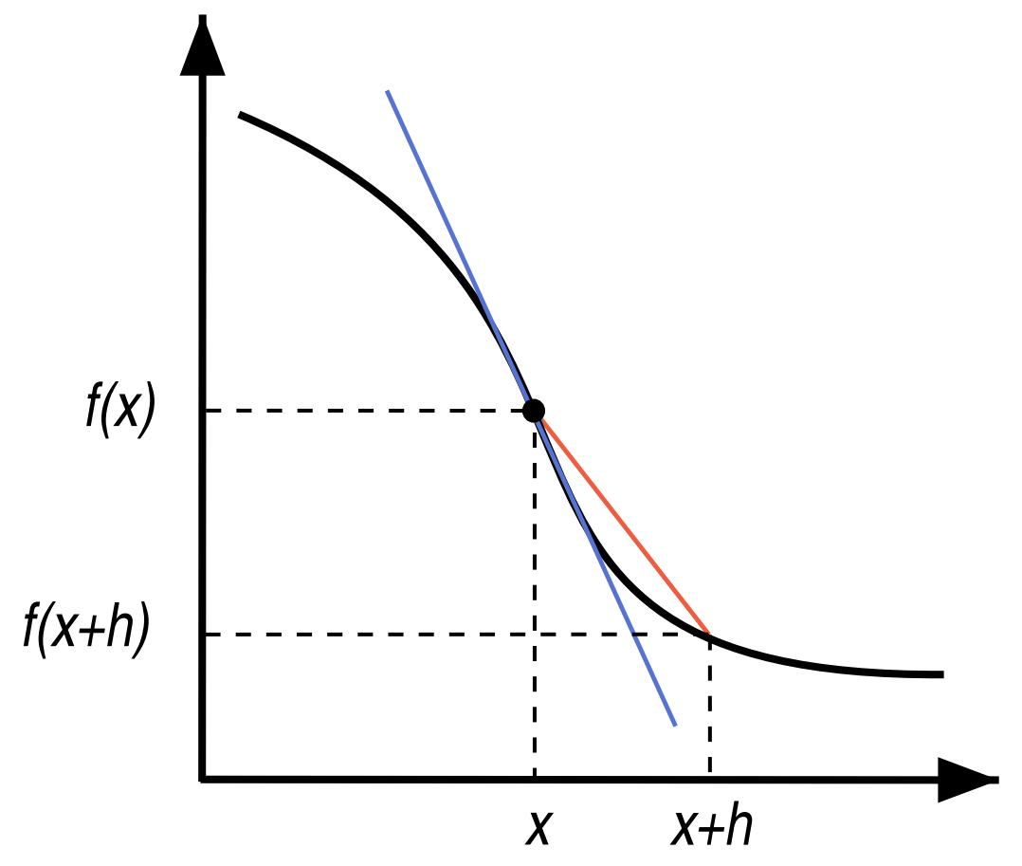
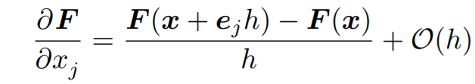
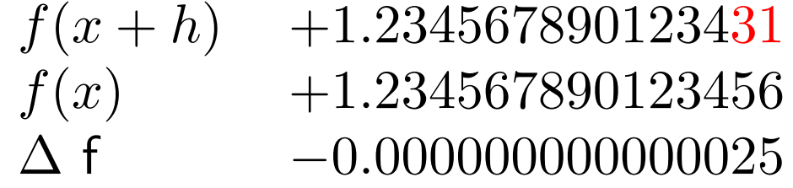
Finite difference is easy

Slide 10
Finite difference is easy, but…
Treats your model as a black-box
Expensive
Accuracy can be bad, especially close to the optimal point

Slide 11
It’s not a good idea to finite difference across solvers
Seriously… don’t do this unless you really have to.
It’s expensive (you have to make your solver tolerances really tight)
It’s inaccurate
It will probably make your optimization converge slowly!
Lots of papers on this topic:
E. S. Hendricks and J. S. Gray, “Pycycle: a tool for efficient optimization of gas turbine engine cycles,” Aerospace, vol. 6, iss. 87, 2019.
E. S. Hendricks, “A multi-level multi-design point approach for gas turbine cycle and turbine conceptual design,” PhD Thesis, 2017.
J. S. Gray, T. A. Hearn, K. T. Moore, J. Hwang, J. Martins, and A. Ning, “Automatic Evaluation of Multidisciplinary Derivatives Using a Graph-Based Problem Formulation in OpenMDAO,” in 15th AIAA/ISSMO Multidisciplinary Analysis and Optimization Conference, 2014.
J. S. Gray, K. T. Moore, T. A. Hearn, and B. A. Naylor, “Standard Platform for Benchmarking Multidisciplinary Design Analysis and Optimization Architectures,” AIAA Journal, vol. 51, iss. 10, p. 2380–2394, 2013.
C. Marriage and Martins, J. R. R. A. “Reconfigurable Semi-Analytic Sensitivity Methods and MDO Architectures Within the πMDO Framework”, in Proceedings of the 12th AIAA/ISSMO Multidisciplinary Analysis and Optimization Conference, Victoria, BC, 2008.

Slide 12
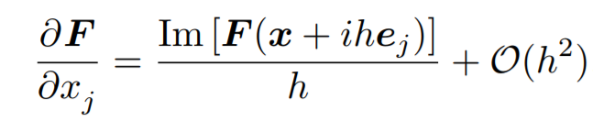
Complex step is more accurate than FD, but…
Treats your models as a gray-box (might require code modification)
Even more expensive than FD
Some functions are tricky…
min(), max(), abs() can cause issues
[Martins et al., ACM TOMS, 2003]

Slide 13
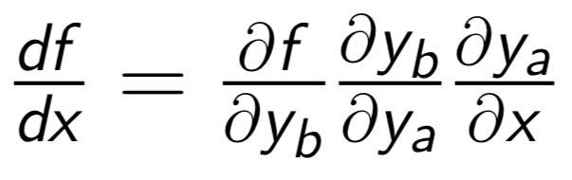
Analytic derivatives are both fast and accurate!

Slide 14
What about models with coupling?

Slide 15
How do you differentiate through this convergence loop?
We’ll need a nonlinear solver to converge this coupling.
The solver loop changes the way you compute analytic derivatives

Slide 16
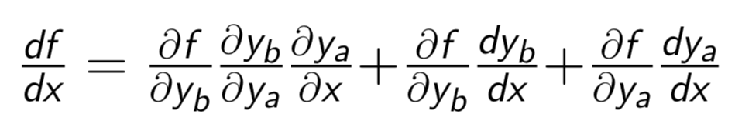
Manually computing analytic derivatives for coupled models takes a lot of work

Slide 17
How do compute these extra terms?
These terms will be computed using adjoints!

Slide 18
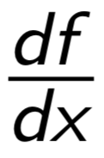
When models get really big … have fun!
= ???
Lets be honest, this just isn’t going to happen!

Slide 19
OpenMDAO can compute these total derivatives for you, automatically!
= [ask OpenMDAO]
For a deep dive on the math:
[Martins and Hwang 2013]
[Hwang and Martins 2018]

Slide 20
OpenMDAO splits total derivative computation into two steps
Computing the partial derivatives for each component
Solving a linear system for total derivatives

Slide 21
OpenMDAO splits total derivative computation into two steps
Computing the partial derivatives for each component
Numerical approach: FD/CS
Analytic approach: hand derivation or algorithmic differentiation
Mix and match numerical and analytic
You are responsible for this step, but OpenMDAO can help you a bit

Slide 22
OpenMDAO splits total derivative computation into two steps
1) Computing the partial derivatives for each component
2) Solving a linear system for total derivatives OpenMDAO does this automatically using a library of different linear solvers for different problems

Slide 23
By using OpenMDAO’s analytic derivative functionality you can
Efficiently solve optimization problems with 1000’s of design variables or thousands of constraints
Get total derivatives across a complicated model, by providing only partial derivatives of each component
Mix and match different techniques for computing partial derivatives

Slide 24
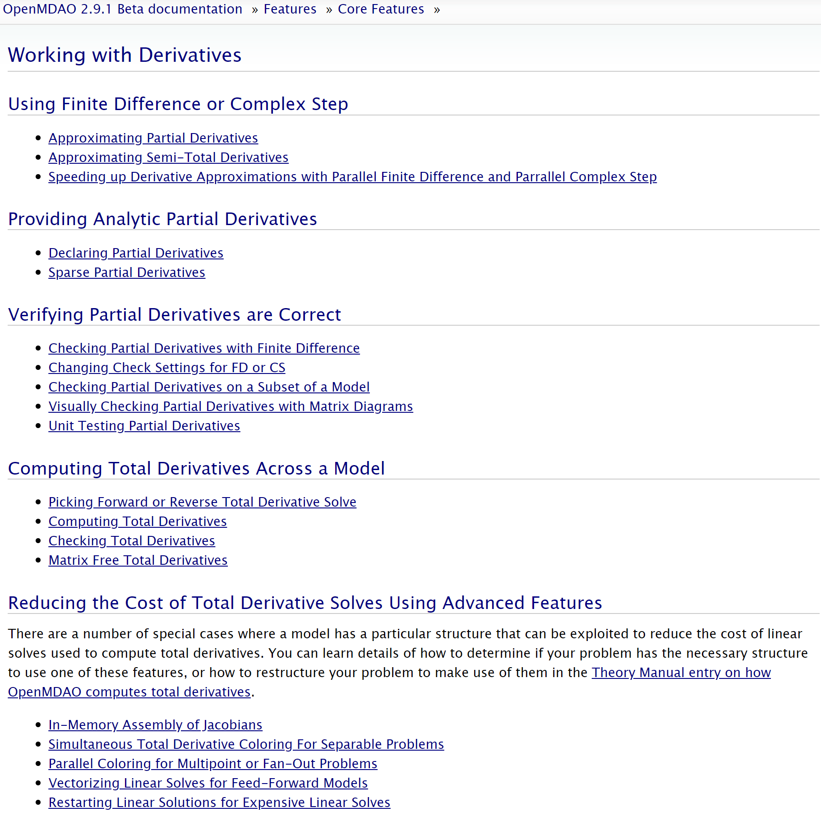
OpenMDAO docs have a great amount of details and examples
Search bar is a lifesaver
http://openmdao.org/twodocs/versions/latest/features/core_features/working_with_derivatives/index.html

Slide 25
OpenMDAO docs have a great amount of details and examples
http://openmdao.org/twodocs/versions/latest/features/core_features/working_with_derivatives/index.html

Slide 26
Computing partial derivatives of an ExplicitComponent
Hand-derived
Sparse hand-derived
Approximated (finite-difference or complex-step)
Under the `explicit_examples` folder in the repo

Slide 27
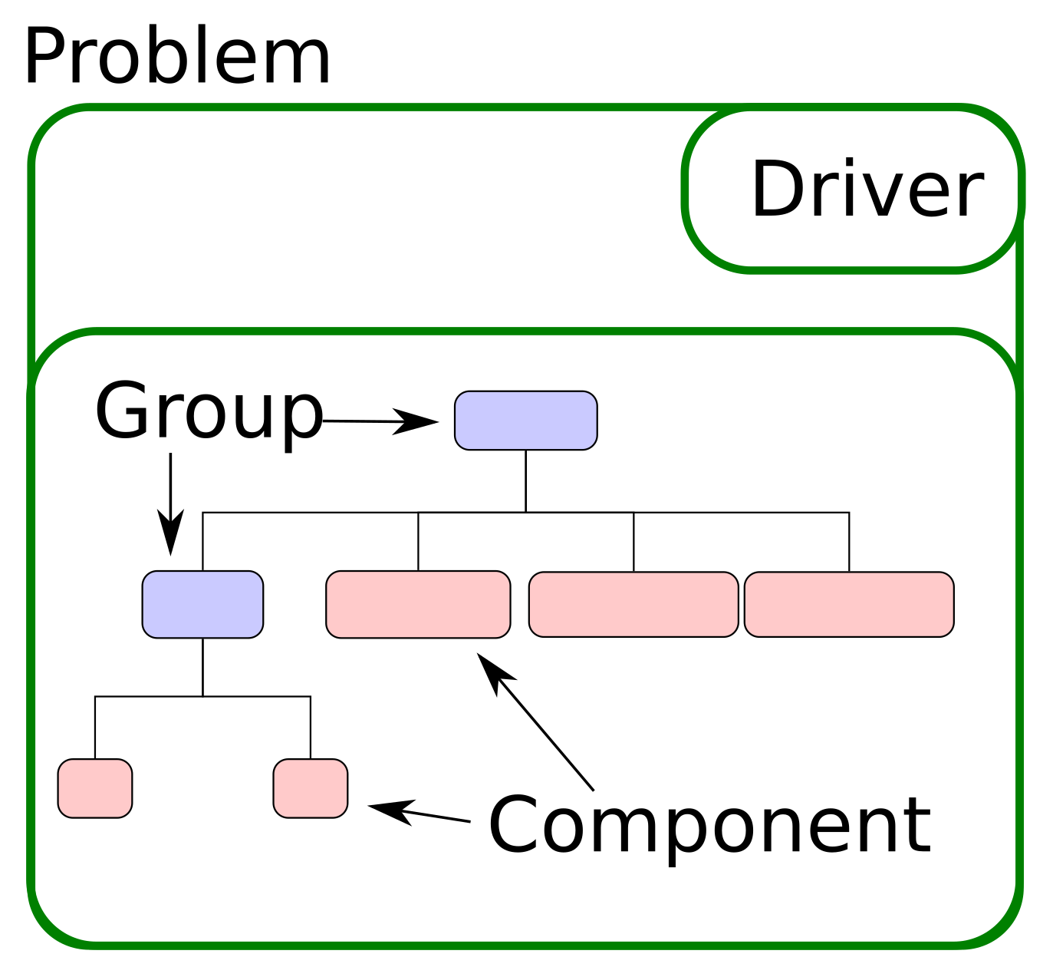
ExplicitComponent class
Used for doing explicit calculations
Inputs → Outputs
Can be as simple as a one-line calculation, or as complex as an adjoint CFD solver

Slide 28
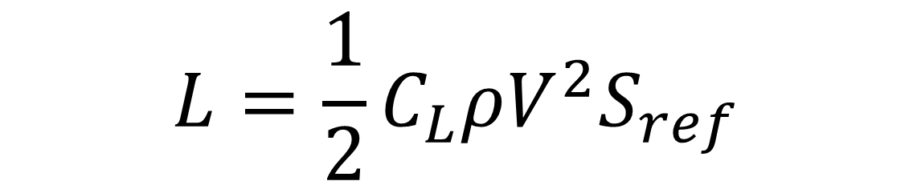
A simple ExplicitComponent example: Calculating lift from CL
$$L=\frac{1}{2}C_{L}ρV^{2}S_{ref}$$

Slide 29
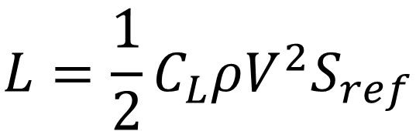
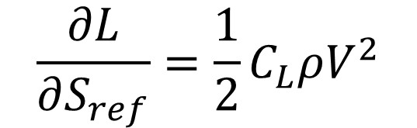
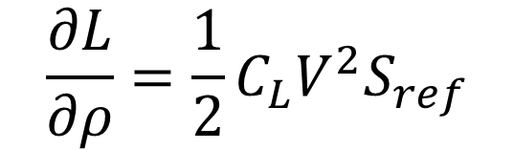
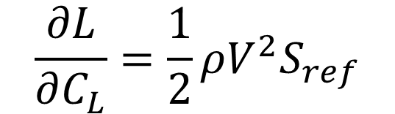
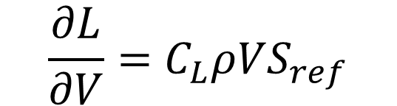
You can analytically compute the partials by hand
$$\frac{∂L}{∂V}=C_{L}ρVS_{ref}$$
$$\frac{∂L}{∂C_{L}}=\frac{1}{2}ρV^{2}S_{ref}$$
$$L=\frac{1}{2}C_{L}ρV^{2}S_{ref}$$
$$\frac{∂L}{∂ρ}=\frac{1}{2}C_{L}V^{2}S_{ref}$$
$$\frac{∂L}{∂S_{ref}}=\frac{1}{2}C_{L}ρV^{2}$$

Slide 30
OpenMDAO can approximate partial derivatives for you
Can use the finite-difference or complex-step methods to approximate the partials derivatives
This is generally more computationally expensive than analytic derivatives
It requires very little additional programmer time

Slide 31
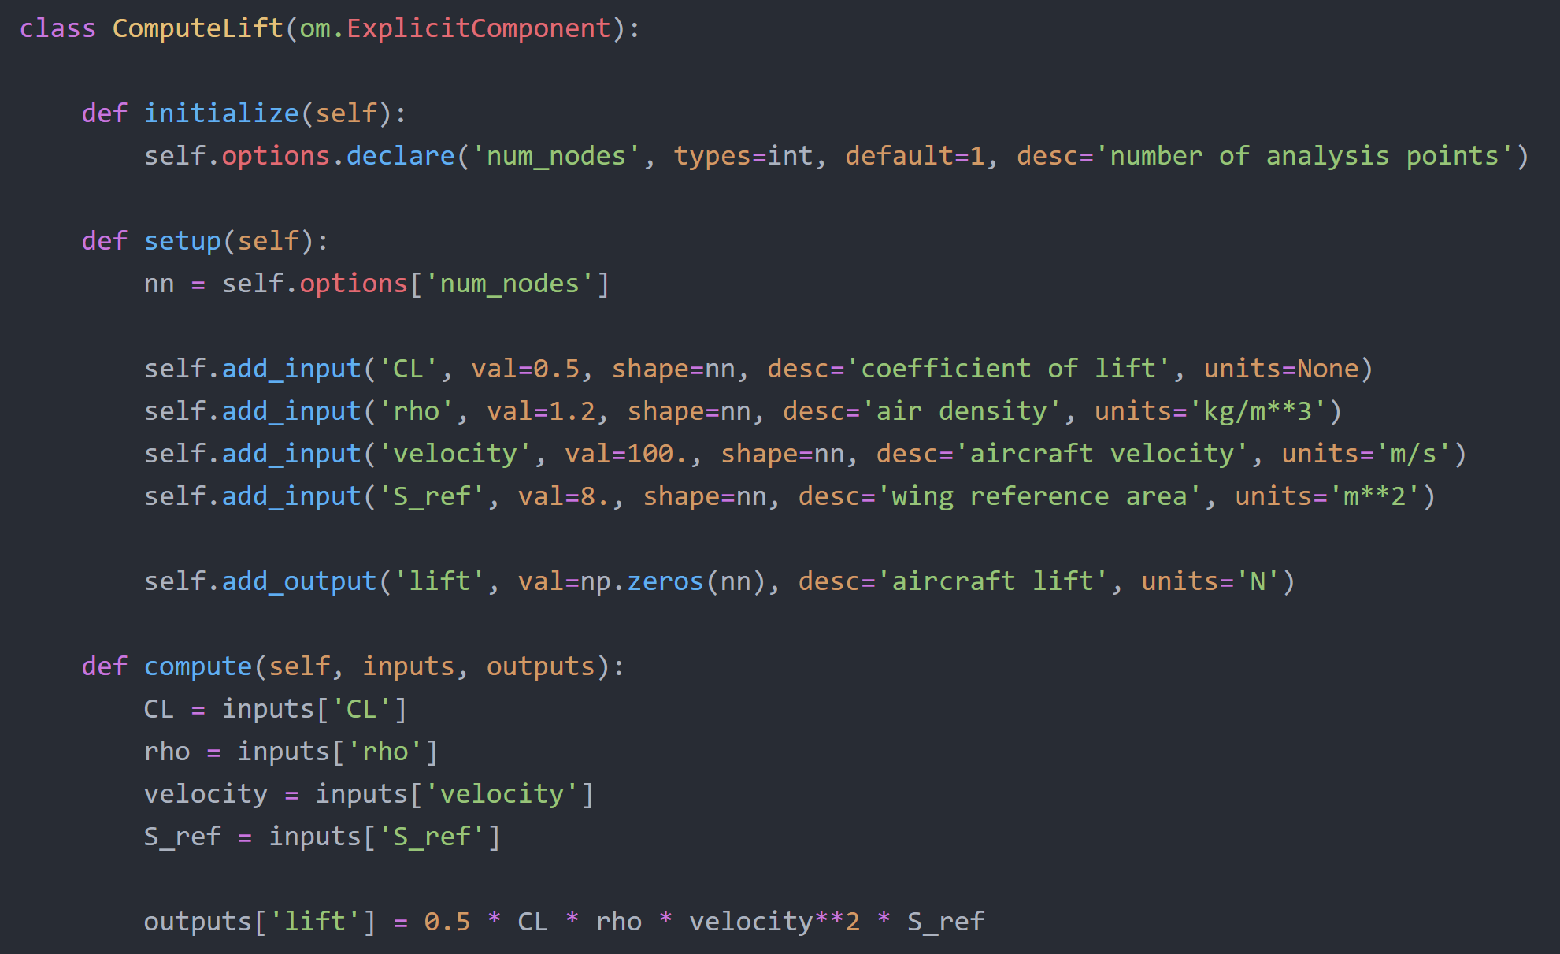

$$L=\frac{1}{2}C_{L}ρV^{2}S_{ref}$$

Slide 32
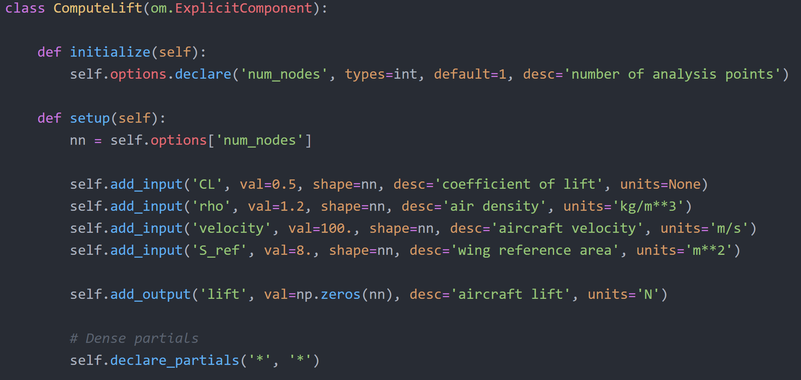
We tell OpenMDAO that all outputs depend on all inputs

Slide 33
The Jacobian is a matrix with one row for each output, and one column for each input

Slide 34
But each entry in that matrix is really a sub-matrix!
Each input is really a vector
Each output is really a vector
Each entry of the vector is totally separate from all others
So each partial is really a square matrix, with entries only on the diagonal

Slide 35
But each entry in that matrix is really a sub-matrix!

Slide 36
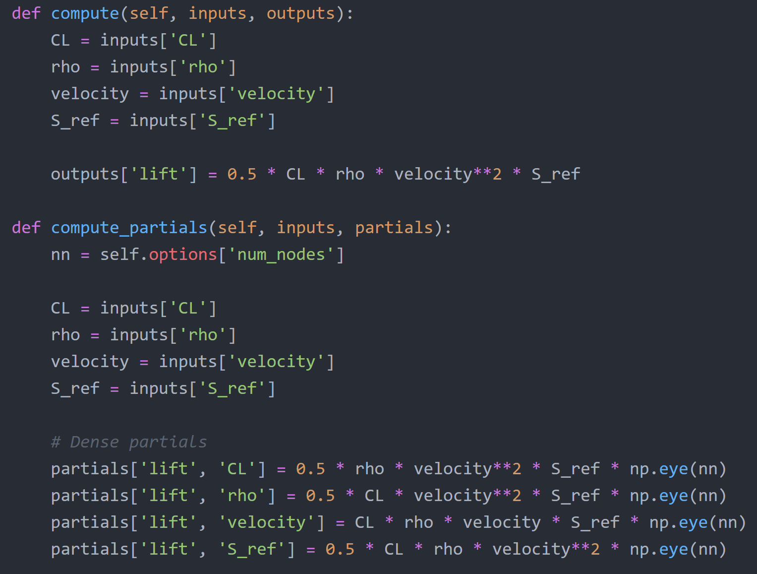
Give OpenMDAO the expressions for partial derivatives we computed before
Account for the shape of the Jacobian

Slide 37
check_partials output
------------------------- Component: ExecComp 'oew' ------------------------- '<output>' wrt '<variable>' | fwd mag. | check mag. | a(fwd-chk) | r(fwd-chk) ------------------------------------------------------------------------------- 'W_empty' wrt 'TOW' | 6.0000e-01 | 6.0000e-01 | 2.3842e-08 | 3.9736e-08 ------------------------------------ Component: BatteryWeight 'batterywt' ------------------------------------ '<output>' wrt '<variable>' | fwd mag. | check mag. | a(fwd-chk) | r(fwd-chk) ----------------------------------------------------------------------------------- 'W_battery' wrt 'LoverD' | 0.0000e+00 | 9.6353e+01 | 9.6353e+01 | 1.0000e+00 >ABS_TOL >REL_TOL 'W_battery' wrt 'TOW' | 0.0000e+00 | 3.2118e-01 | 3.2118e-01 | 1.0000e+00 >ABS_TOL >REL_TOL 'W_battery' wrt 'eta_electric' | 0.0000e+00 | 2.0946e+03 | 2.0946e+03 | 1.0000e+00 >ABS_TOL >REL_TOL 'W_battery' wrt 'eta_prop' | 0.0000e+00 | 2.3218e+03 | 2.3218e+03 | 1.0000e+00 >ABS_TOL >REL_TOL 'W_battery' wrt 'range_desired' | 0.0000e+00 | 1.2847e+01 | 1.2847e+01 | 1.0000e+00 >ABS_TOL >REL_TOL 'W_battery' wrt 'spec_energy' | 0.0000e+00 | 6.4235e+00 | 6.4235e+00 | 1.0000e+00 >ABS_TOL >REL_TOL ---------------------------- Component: WeightBuild 'tow' ---------------------------- '<output>' wrt '<variable>' | fwd mag. | check mag. | a(fwd-chk) | r(fwd-chk) ------------------------------------------------------------------------------- 'TOW' wrt 'W_battery' | 7.5000e+01 | 1.0000e+00 | 7.6000e+01 | 7.6000e+01 >ABS_TOL >REL_TOL 'TOW' wrt 'W_empty' | 7.5000e+01 | 1.0000e+00 | 7.6000e+01 | 7.6000e+01 >ABS_TOL >REL_TOL 'TOW' wrt 'W_payload' | 7.5000e+01 | 1.0000e+00 | 7.6000e+01 | 7.6000e+01 >ABS_TOL >REL_TOL ########################################################### Sub Jacobian with Largest Relative Error: WeightBuild 'tow' ########################################################### '<output>' wrt '<variable>' | fwd mag. | check mag. | a(fwd-chk) | r(fwd-chk) ------------------------------------------------------------------------------- 'TOW' wrt 'W_battery' | 7.5000e+01 | 1.0000e+00 | 7.6000e+01 | 7.6000e+01

Slide 38
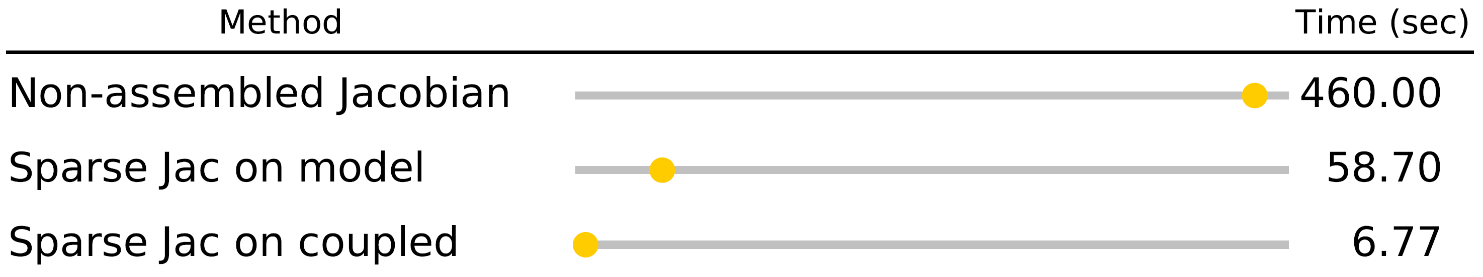
Sparse partial derivatives can greatly increase speed
We saw an 80x speed-up by using sparse Jacobians intelligently in OpenAeroStruct

Slide 39
Since each partial is diagonal, we don’t actually need to provide all those 0’s

Slide 40
Since each partial is diagonal, we don’t actually need to provide all those 0’s

Slide 41
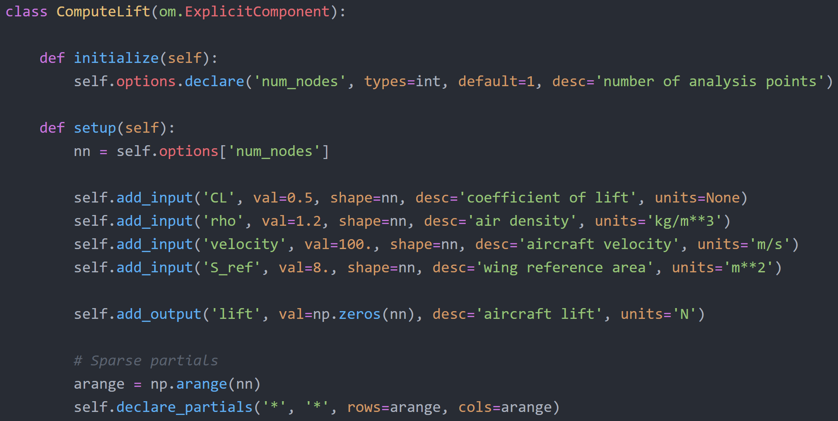
Tell OpenMDAO about the sparsity pattern of the Jacobian

Slide 42
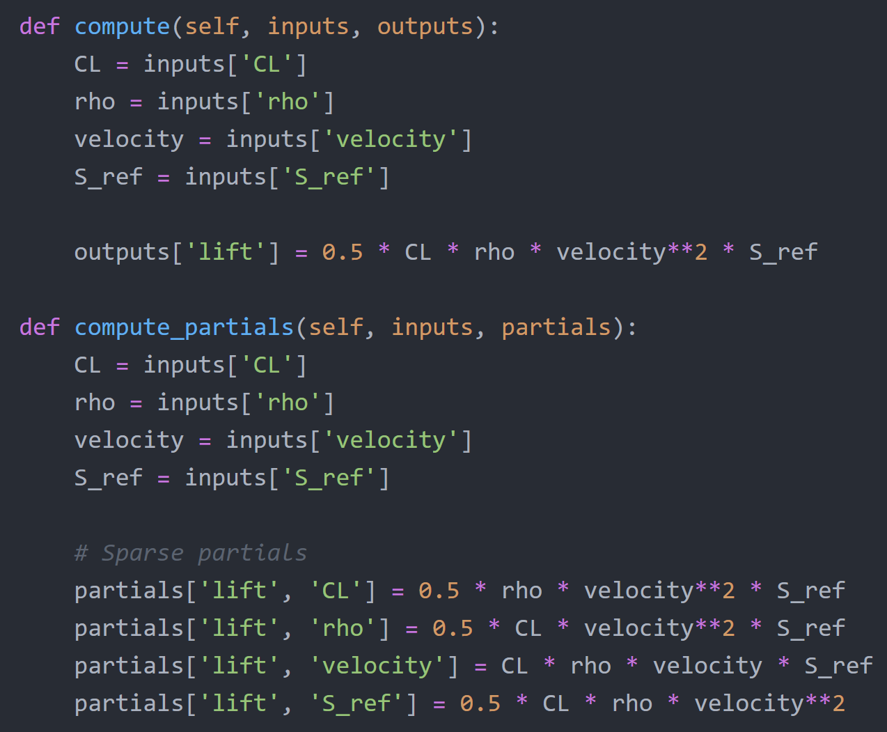
Because our expected partials shapes are vectors, now we’re just giving OpenMDAO the non-zero entries

Slide 43
What if we’re too lazy to compute the partials by hand? ☺

Slide 44
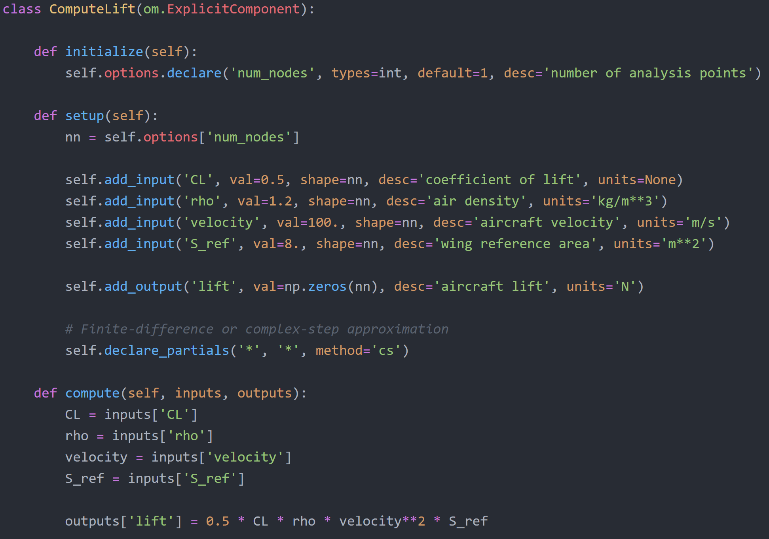
OpenMDAO can approximate derivatives automatically. Just note that they will be dense!

Slide 45
Rules of thumb for computing partials
Fine to start out with FD partials while getting your model set up!
For cheap black-box codes:
FD might be ok for production runs
CS is better if you can do it!
For “expensive” codes (anything with an internal solver):
Implement as ImplicitComponent (expose the states/residuals to OpenMDAO)
Can still FD the residual if you need to
Analytic derivatives typically cost a lot for these components

Slide 46
Computing partial derivatives of an ImplicitComponent
Can use the same techniques to obtain partials as explicit
Compute the partials of the residuals with respect to the inputs and outputs
Under the `implicit_examples` folder in the repo

Slide 47
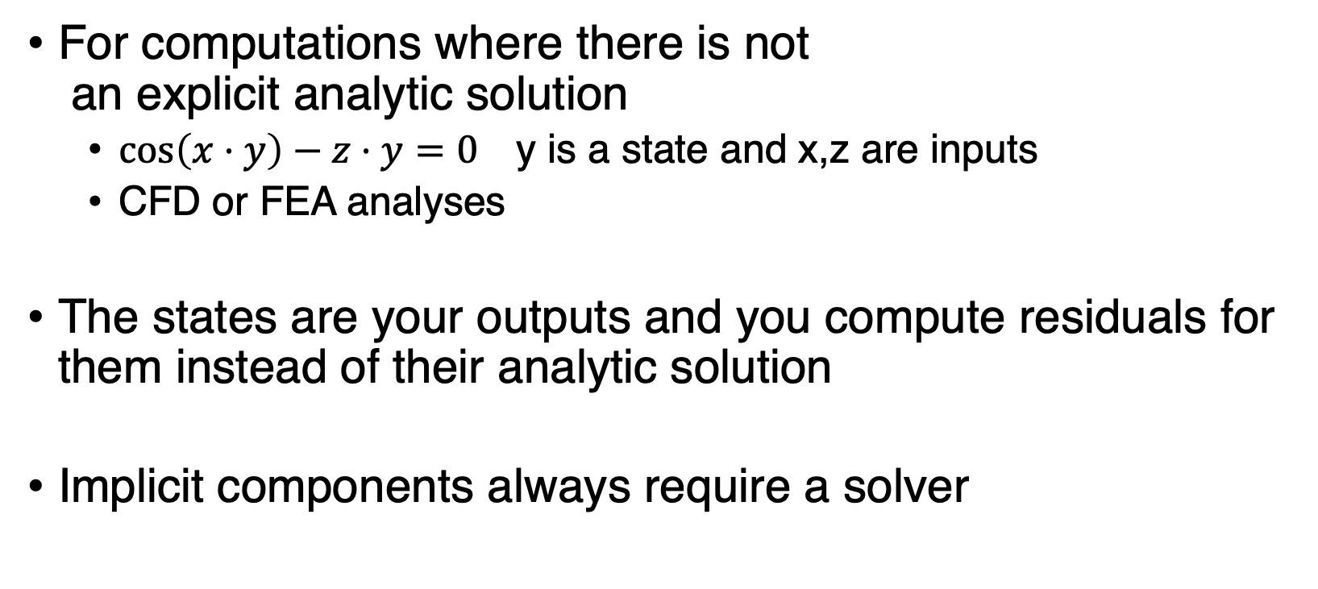
When do we need to use implicit components?
For computations where there is not an explicit analytic solution
$\cos\left(x⋅y\right)−z⋅y=0$ y is a state and x,z are inputs
CFD or FEA analyses
The states are your outputs and you compute residuals for them instead of their analytic solution
Implicit components always require a solver
http://openmdao.org/twodocs/versions/latest/advanced_guide/implicit_comps/defining_icomps.html

Slide 48
Implicit components can use any of the derivative techniques described previously
Hand derived analytic partials (sparse or dense!)
Finite-difference or complex-step dense approximations

Slide 49
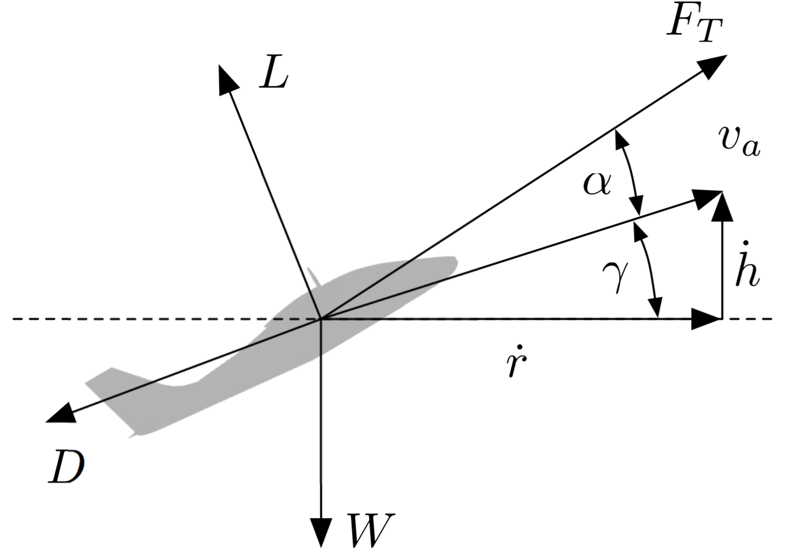
Example implicit component: Aircraft in flight equilibrium
$$F_{T}\cos\left(α\right)−D−W\sin\left(γ\right)=0$$
$$F_{T}\sin\left(α\right)+L−W\cos\left(γ\right)=0$$
[Falck et al., AIAA SciTech, 2017]

Slide 50
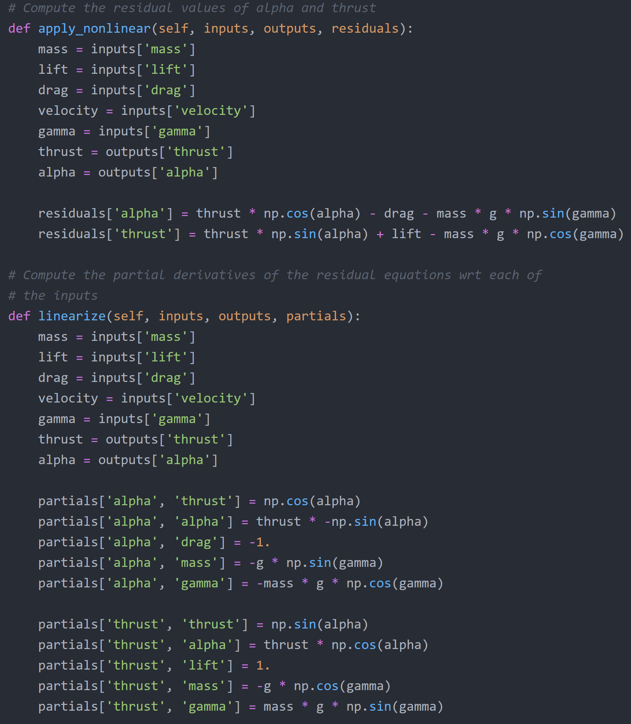
$$F_{T}\cos\left(α\right)−D−W\sin\left(γ\right)=0$$
$$F_{T}\sin\left(α\right)+L−W\cos\left(γ\right)=0$$
Define residuals (i.e. the values we want to drive to 0)

Slide 51
Compute partial derivatives of the residuals wrt the inputs

Slide 52
Advanced topics related to obtaining derivatives
Partial and total derivative coloring
Parallel finite difference and complex step
Debugging derivative computations

Slide 53
OpenMDAO docs have a great amount of details and examples
Search bar is a lifesaver
http://openmdao.org/twodocs/versions/latest/features/core_features/working_with_derivatives/index.html

Slide 54
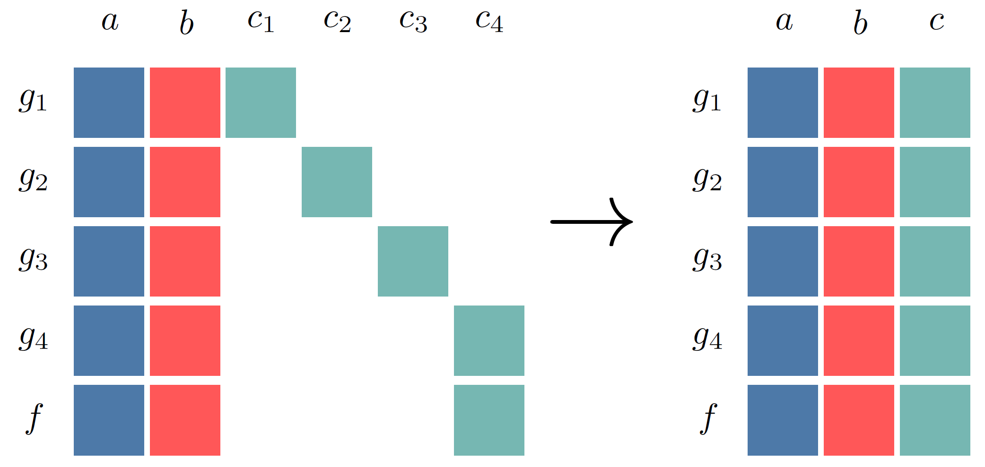
Getting system derivatives efficiently: automatic Jacobian coloring
http://openmdao.org/twodocs/versions/latest/features/core_features/working_with_derivatives/simul_derivs.html

Slide 55
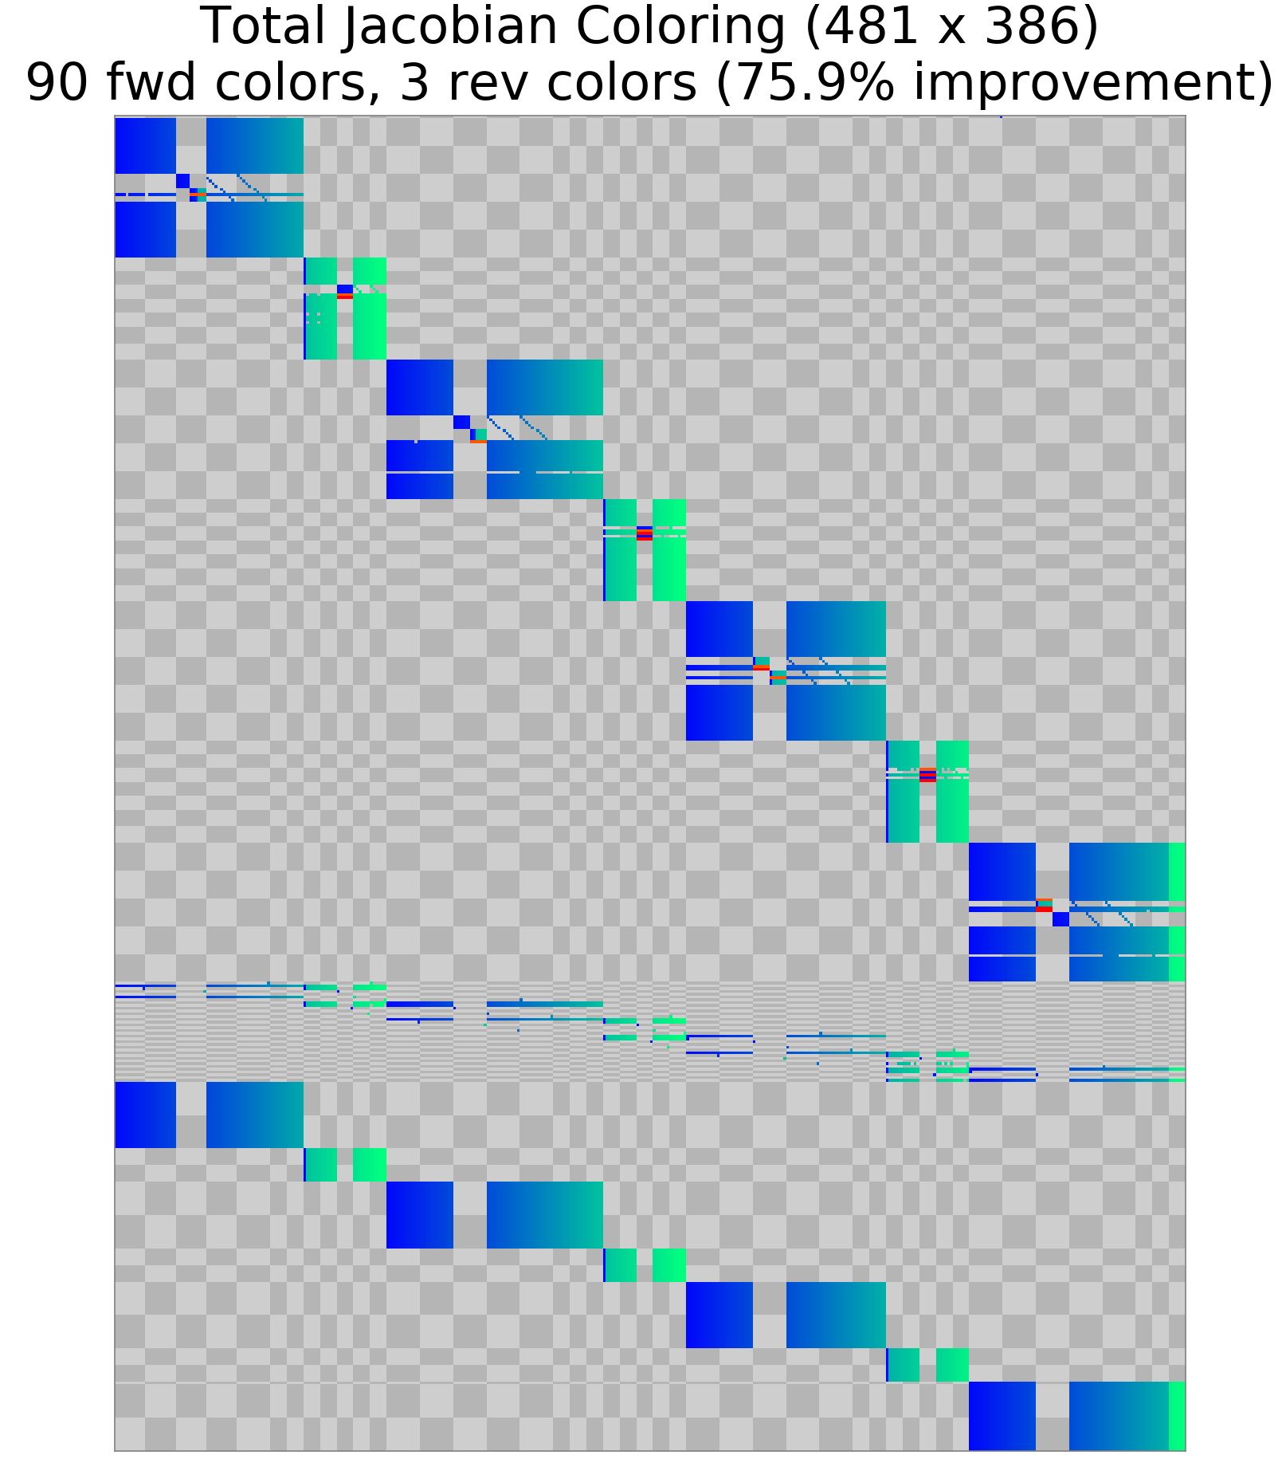
Automatic coloring for real problems can be extremely beneficial
Designers don’t need prior knowledge about the sparsity of their optimization problem to use total coloring

Slide 56
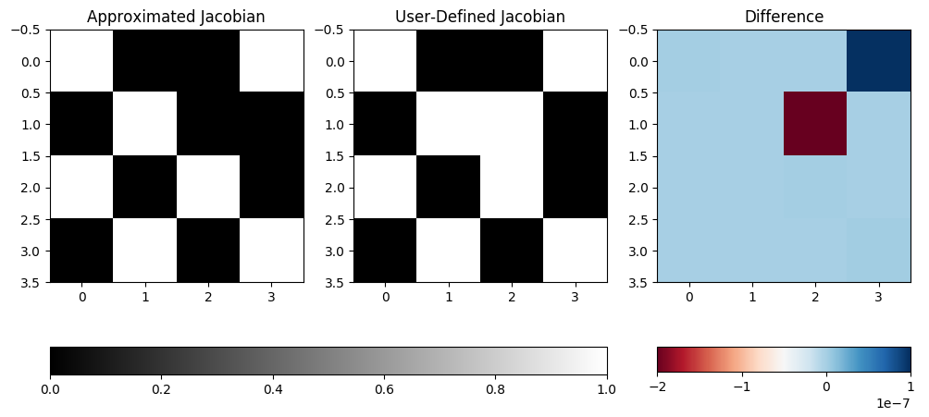
Visual debugging tools for partials derivatives are helpful for sparse patterns

Slide 57
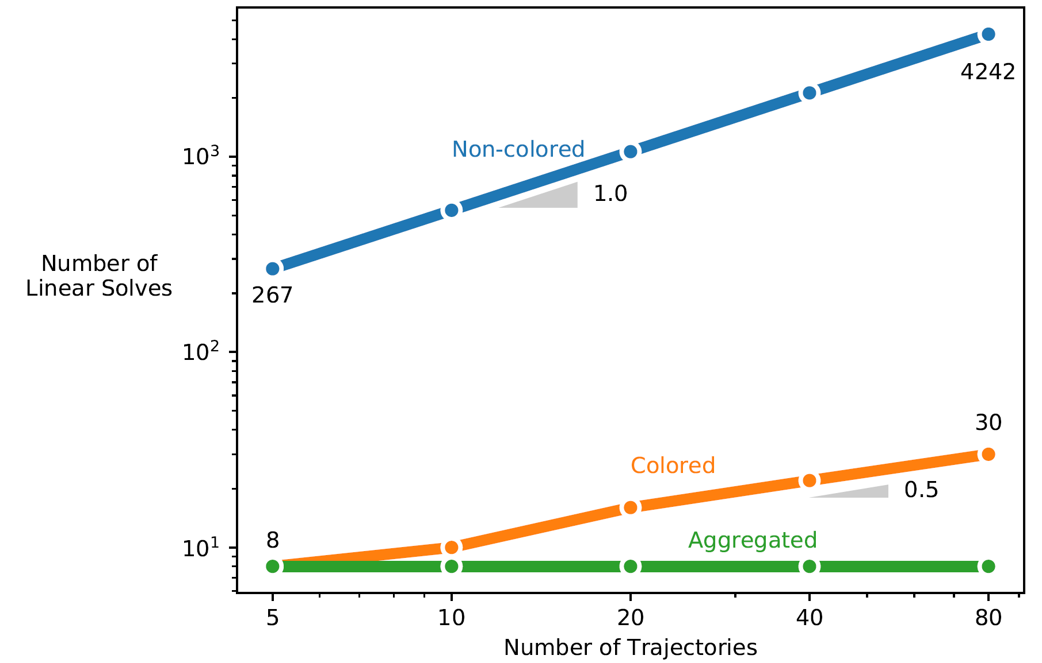
Getting system derivatives efficiently: automatic Jacobian coloring
Gray, Hearn, and Naylor, Using graph coloring to compute total derivatives more efficiently in OpenMDAO, AIAA 2019-3108

Slide 58
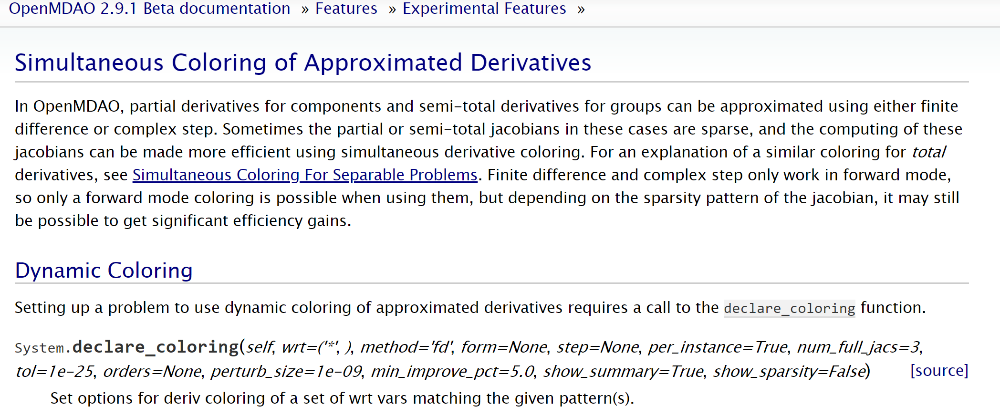
Coloring can also be used for partial derivatives, though it is experimental
http://openmdao.org/twodocs/versions/latest/features/experimental/simul_coloring_fd_cs.html

Slide 59
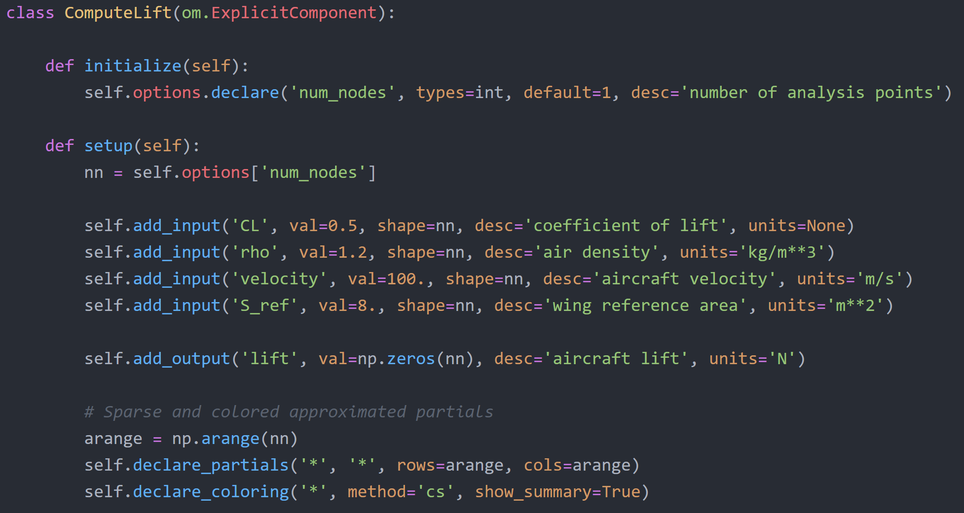
Can use partial derivative coloring to speed up approximation time

Slide 60
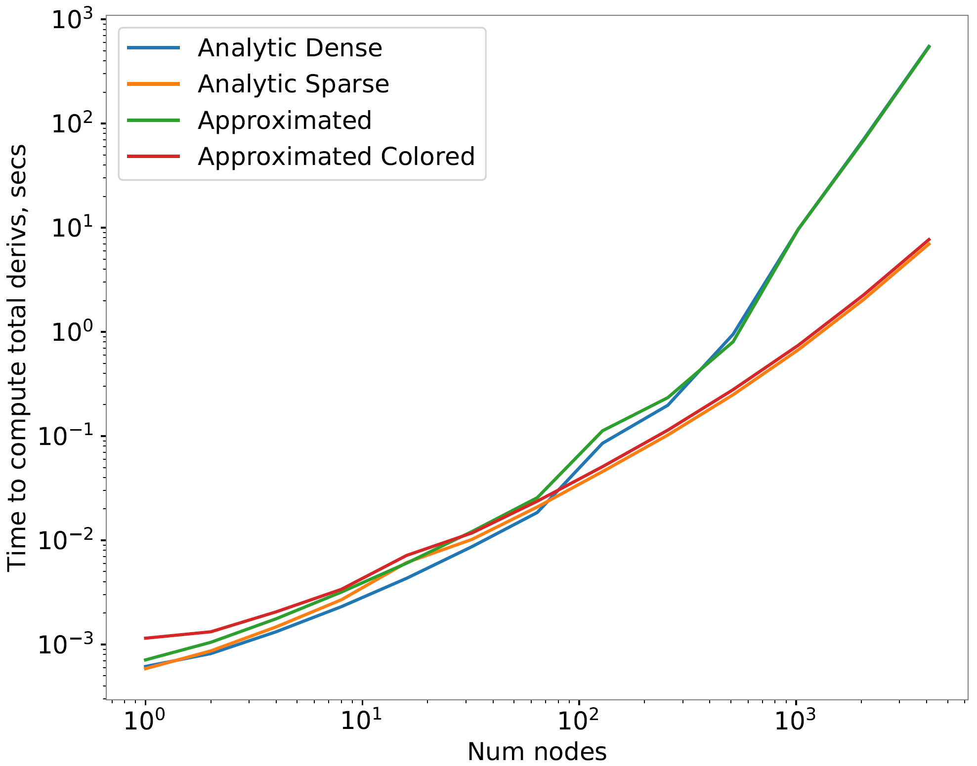
Approximated colored sparse derivatives can save you orders of magnitude computation time

Slide 61
Try out these derivative features and suggest others that might be useful
Let the dev team know what works and what doesn’t
Submit a POEM if you want to see changes

Slide 63
Download these slides and tutorial scripts from GitHub
https://github.com/openmdao/openmdao_training
Our materials for today are in the `getting_derivatives_in_openmdao` folder

